Slide 1
WICS - Flappy Anteater Python Tutorial
Session 1
April 21st 2014

Slide 2
Announcements
5 weeks (Week 4 – Week 8)
Participants will receive swag at the end
Tutorials are aimed at beginners
Those with experience may start the project

Slide 3
Join the Facebook Group
https://www.facebook.com/groups/725853740799872/
We’ll post the slides on this page
Any other updates will also be posted here

Slide 4
Groups
You may work in a group or individually
At the beginning of the 3rd session (after the tutorials), we’ll record the names of all the participants
Participants that turn in the project will enter the raffle

Slide 5
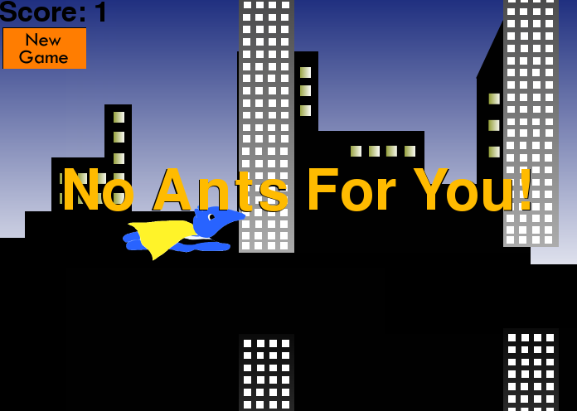
Let’s start! ☺

Slide 6
Importing Pygame
In order to create Flappy Anteater, you have to import pygame, which is a set of modules that are used for creating games. It provides computer graphics and sound libraries that are designed to be used with Python.
Before you import pygame, you have to download pygame from pygame.org
(To know which version of Python is installed in your
computer, open an IDLE window.)
Here’s the link: http://tinyurl.com/pygamedownloads
import pygame will import all the available modules into the pygame package

Slide 7
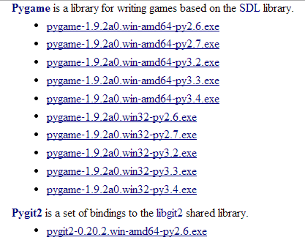

Slide 8
Importing Modules
A module is a file that contains Python definitions and statements. It consists of functions, classes, and/or variables.
For example, the built in module called math contains math operations that can be used by importing the module onto your own module. If you wanted to calculate the square root of a number, you would have to call the square root function from the math module.
import math
math.sqrt(enter_number_here)

Slide 9
Initializing pygame
Before using pygame, you have to initialize it. You can find the function by looking at the pygame documentation -> pygame.
pygame.init() will initialize all imported pygame modules

Slide 10
Changing window title
You can change the window title by looking at the pygame documentation -> display. There’s a function that will allow you to set the window caption.
pygame.display.set_caption(“enter_string_here”) sets the current window caption

Slide 11
Screen coordinates
(0, 0 at top left corner instead of bottom left)
In Pygame, the coordinate system is slightly different than the one that we’re used to seeing in math. The origin point (0, 0) is on the top-left corner, and the x-coordinates increase as you move to the right and the y-coordinates increase as you move down.

Slide 12
If you had an area that was 300 pixels wide and 400 pixels tall, then the coordinate system would look like this:

Slide 13
Creating a screen (size)
You can change the size of the window by looking at the pygame documentation -> display. There’s a function that will allow you to create a screen.
pygame.display.set_mode(enter_width, enter_height) will initialize a window or screen for display

Slide 14
Quitting pygame
Calling the quit() function will ensure that all initialized modules are uninitialized when Python finishes. You can find the function by looking at the pygame documentation -> pygame.
pygame.quit() uninitializes all pygame modules

Slide 15
Using pygame documentation
Like in the Python documentation, you can search up the various functions and how to use them in pygame by looking at the documentation.
Link: http://www.pygame.org/docs/

